Slide 1

E-Commerce
Platform

Slide 2

Project Description
Comprehensive Client-Server Application:
Developed using Python's socket programming and SQLite3 for database management, facilitating secure online shopping with user registration, authentication, product browsing, and order placement.
Reliable TCP Communication:
All operations run over TCP, ensuring reliable and ordered data transmission for transaction and user data integrity.
Lightweight and Efficient Architecture:
Leveraging low-level socket programming avoids the overhead of external frameworks, while SQLite3 provides an efficient file-based database for streamlined data storage and retrieval.
Key Features:
User management with role-based access, dynamic product catalogs, and robust order processing within a secure, high-performance environment.

Slide 3
Modular Design:
The application is divided into modules, each handling a specific function like user management, product management, and order processing.
This separation of concerns enhances maintainability and makes it easier to update and add new features.
Reliable Communication:
All core e-commerce functionalities are conducted over TCP connections.
TCP ensures reliable, ordered, and efficient communication, which is crucial for maintaining transaction integrity and safeguarding user data.
Security and Integrity:
TCP communication provides secure data transmission, essential for protecting sensitive information during transactions.
User-Friendly Platform:
The platform delivers a smooth, secure, and user-friendly online shopping experience for both consumers and administrators.

Slide 4


RELIABLE DATA TRANSFER
Design requirements of transport services
We utilize TCP connections to guarantee reliable data transfer. This is crucial for maintaining the integrity of transactions and user information within our e-commerce platform.
TIMING
TCP's flow control and congestion control mechanisms help manage the timing of data packets, providing a smooth user experience without significant delays or data overlap issues.
THROUGHPUT
By optimizing socket programming and supporting multiple concurrent connections, our platform achieves high throughput, ensuring fast and efficient communication between clients and the server.
SECURITY
Secure TCP connections are employed to protect data in transit. Additionally, the platform incorporates security measures such as input validation, password hashing, and user authentication protocols to safeguard user information and prevent security breaches.

Slide 5
Requirement | Description
Reliable Data Transfer | Critical operations (registration, login, order placement, payment processing) require guaranteed, reliable, and ordered data transfer. TCP is used to meet this requirement.
Timing | The platform should handle user interactions (like login, order placement, payment processing) with minimal delay. TCP ensures timely data transfer for transactions.
Throughput | The platform must support multiple concurrent connections without significant performance degradation. TCP is optimized for high throughput in the respective use cases.
Security | Secure transmission of user data and transactions is essential. TCP is used with security protocols to ensure data integrity and protection against unauthorized access.

Slide 6
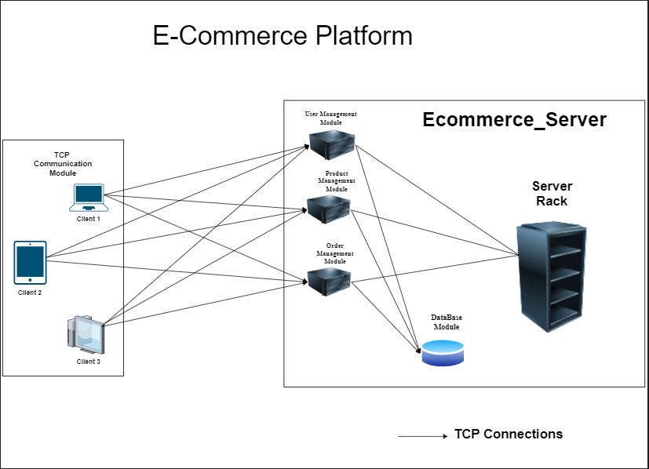
Architecture Diagram

Slide 7
User Module
Type of transport protocol
Number of Connections
TCP
Register
1
TCP
Login
1
TCP
Change Password
1
N/A
Logout
0

Slide 8
Product Module
Type of transport protocol
Number of Connections
TCP
Add Product
1
TCP
View Products:
1
TCP
View Categories
1

Slide 9
Order Module
Type of transport protocol
Number of Connections
TCP
View Order History
1
TCP
Place an Order
1

Slide 10

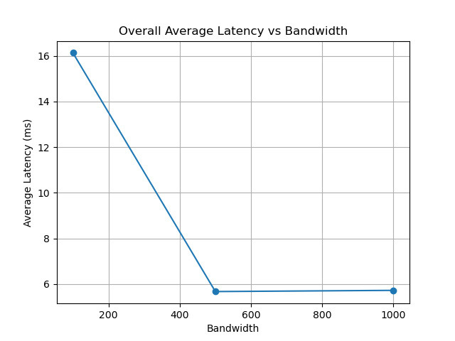
Performance analysis
Latency vs Bandwidth

Slide 11
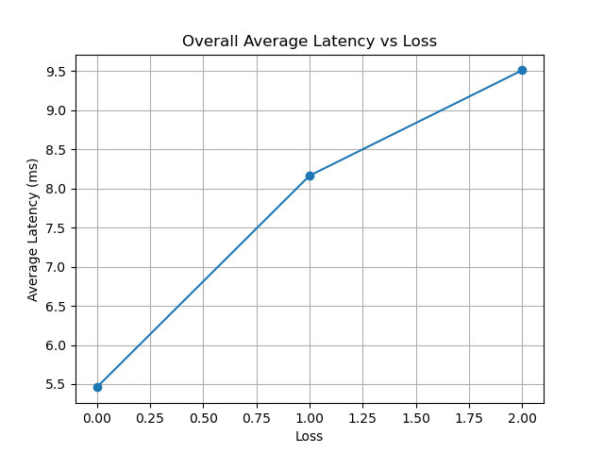
Performance analysis
Latency vs Loss

Slide 12
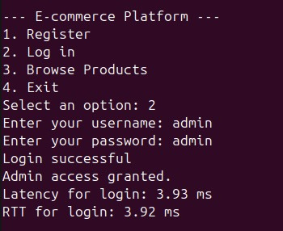
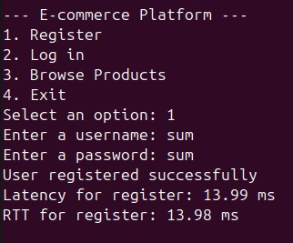
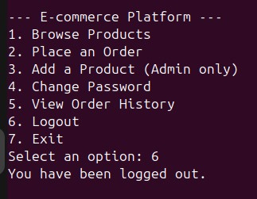
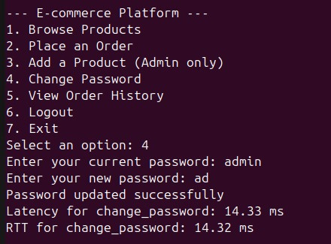
Output

Slide 13
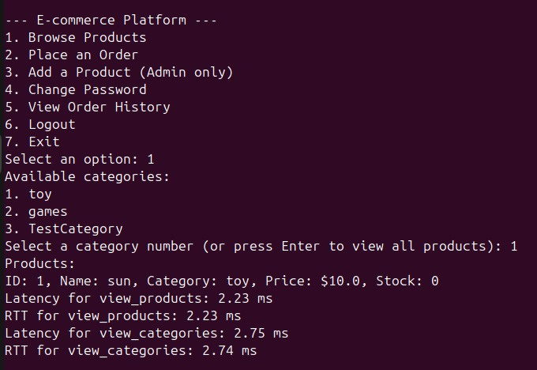
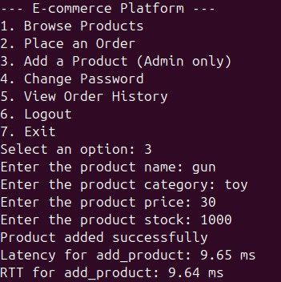
Output

Slide 14
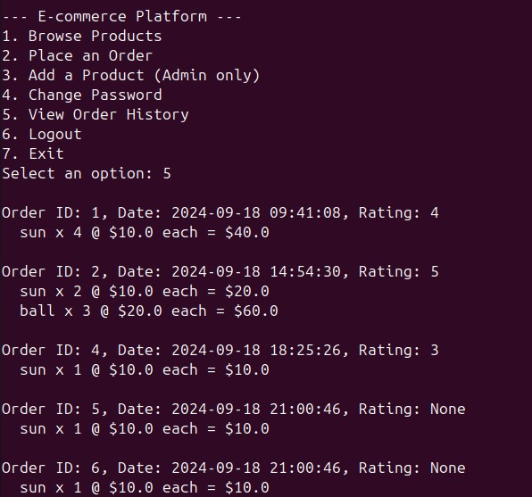
Output

Slide 15
Thank You !!!

